Slide 1
Outline of Today’s Discussion
Independent Samples ANOVA: A Conceptual Introduction
Introduction To Basic Ratios
Basic Ratios In Excel
Cumulative Type I Error & Post-Hoc Tests
One-way ANOVAs in SPSS

Slide 2
Part 1
Independent Samples ANOVA:
Conceptual Introduction

Slide 3
Independent Samples ANOVA
Like the Z-score and the t statistic, the ANOVA (analysis of variance) is also a ratio.
Like the t-test, the ANOVA is used to evaluate the difference between means, within the context of the variability.
The ANOVA is distinct from the t-test, however, in that the ANOVA can compare multiple means to each other (the t-test can only do two at a time).
Let’s compare the t-test & ANOVA a little further…

Slide 4

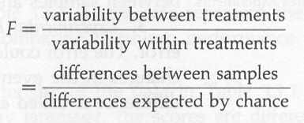
Independent Samples ANOVA
The ANOVA is also called the F Statistic.

Slide 5
Independent Samples ANOVA
Scores vary! It’s a fact of life. :-)
Let’s consider three sources of variability, and then return to of how ANOVA deals with these….
In grad school, you will almost certainly hear the phrase: “Partitioning the Variability”….

Slide 6
Independent Samples ANOVA
One source of variability is the treatment effect - the different levels of the independent variable may cause variations in scores.
Another source of variability is individual differences - participants enter an experiment with different abilities, motivation levels, experiences, etc.. People are unique! This causes scores to vary.
A third source of variability is experimental error - whenever we make a measurement, there is some amount of error –random variation.

Slide 7
Independent Samples ANOVA
Researchers try to minimize those last two sources of variability (individual differences, and experimental error).
They do this by “control” and by “balancing”, as we saw in the last section.
Individual differences and experimental error cause variability, both within and between treatment groups.
By contrast, treatment effects only cause variability between treatment groups…

Slide 8
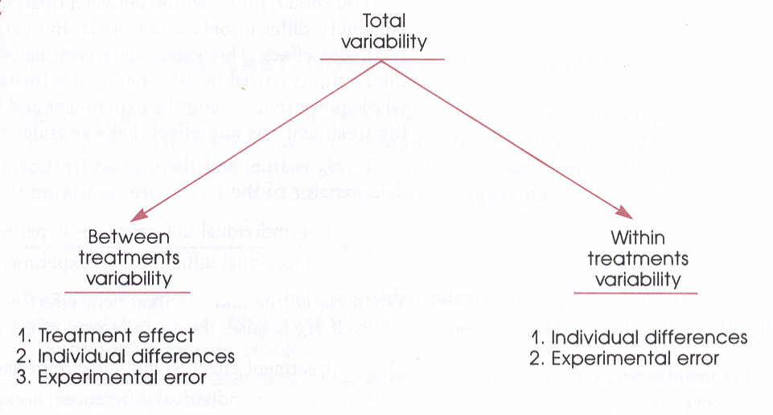
Independent Samples ANOVA
Partitioning The Variability!
Notice that the treatment effect
pertains only to the between group variability.

Slide 9

Independent Samples ANOVA
The ANOVA is also called the F Statistic.
Remember: It’s just another ratio.
…no big wup! ;)
Let’s unpack this thing…

Slide 10

Independent Samples ANOVA
The ANOVA is also called the F Statistic.
Here’s the ANOVA, “unpacked”.

Slide 11

Independent Samples ANOVA
The ANOVA is also called the F Statistic.
Here’s the ANOVA,
“unpacked” in a different way.
Error variation includes both
individual differences & experimental error.

Slide 12
Independent Samples ANOVA
The ANOVA is also called the F Statistic.
Here’s the ANOVA,
“unpacked” in a different way.
Systematic variation includes only
the treatment effects.

Slide 13

Independent Samples ANOVA
The ANOVA is also called the F Statistic.
This is what the null hypothesis predicts.
It states that treatment effects are zero.

Slide 14

Independent Samples ANOVA
The null hypothesis for the ANOVA.

Slide 15

Independent Samples ANOVA
The alternate hypothesis for the ANOVA.

Slide 16
Independent Samples ANOVA
Let’s consider a set of pictures, to further develop some intuitions about the F statistic (i.e., the ANOVA).
Remember that the F statistic is this ratio:
Between Group Variance / Within Group Variance

Slide 17
Independent Samples ANOVA
Total Variance
Here, the
variances
are equal
F ratio = 1
Retain Ho.

Slide 18
Independent Samples ANOVA
Total Variance
Here, the
variances
aren’t equal
F ratio < 1
Retain Ho.

Slide 19
Independent Samples ANOVA
Total Variance
Here, the
variances
aren’t equal
F ratio > 1
Reject Ho!

Slide 20
Independent Samples ANOVA
You remember our old buddy, the variance?
To get the variance we need to determine the sum of squares, then divide by the degrees of freedom (n for a population, n-1 for a sample).
Let’s see the total variance, and how ANOVA breaks it down into smaller portions…

Slide 21
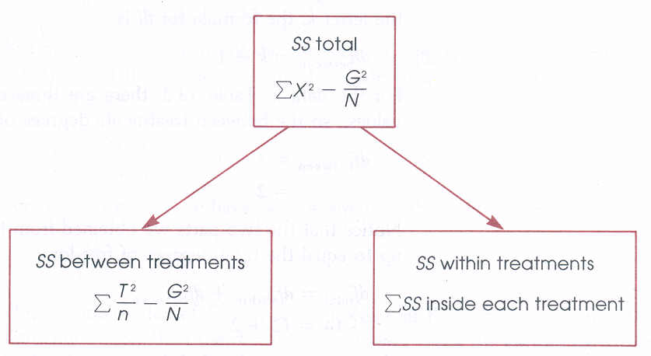
Independent Samples ANOVA
The sums of squares for the ANOVA,
which is also called the F Statistic.

Slide 22
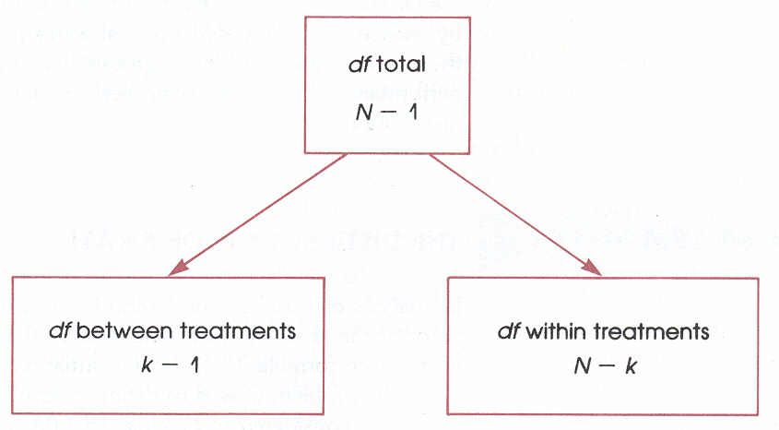
Independent Samples ANOVA
The degrees of freedom for the ANOVA,
which is also called the F Statistic.

Slide 23
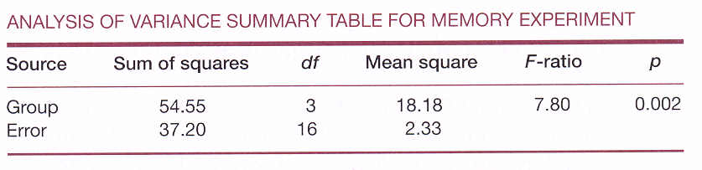
Independent Samples ANOVA
The summary table for the ANOVA,
which is also called the F Statistic.

Slide 24
Part 2
Introduction To Basic Ratios

Slide 25
Introduction To Basic Ratios
There are many methods for computing a single-factor (i.e., ‘one-way’), between-subjects ANOVA.
One method relies on so called “basic ratios”, which are special quantities that allow for simpler (?) manual computations of ANOVA.

Slide 26
Introduction To Basic Ratios
Each basic ratio is symbolized by a somewhat arbitrary capital letter (or perhaps a pair of capital letters).
By convention, basic ratios are written in side of brackets: Example [Y], or [A] or [T].
Let’s look at the most basic of the basic ratios…

Slide 27
Introduction To Basic Ratios
The basic ratio for individual participants is called [Y]
[Y]
[Y] = The sum of the individual squared scores.
(Square them first, then sum them.)

Slide 28
Introduction To Basic Ratios
[Y] = The Sum of the Squared Scores
Raw
Scores
Squared
Scores

Slide 29
Introduction To Basic Ratios
The basic ratio for groups (or conditions) is called [A]
[A]
[A] = The sum of the squared column totals,
divided by # of subjects per condition.
(Square them first, then sum them.)
Each column total corresponds to a
different level (a) of the I.V..

Slide 30
Introduction To Basic Ratios
[A] = The Sum of the Squared Column Totals divided by n.
[A] = (1024 + 196 + 2116) / 6

Slide 31
Introduction To Basic Ratios
The basic ratio for grand total is called [T]
[T]
[T] = The grand total squared,
divided by the total number of scores.
(Sum them first, then square them.)
The total number of scores (N) equals a * n.

Slide 32
Introduction To Basic Ratios
[T] = The Grand Total Squared divided by (capital) N.
[T] = 8464 / 18

Slide 33
Introduction To Basic Ratios
We can use these (and other) basic ratios to ‘build up’ the quantities in our F-Summary table.
Basic ratios are FLEXIBLE in the sense that we can use them for between-subjects or within-subjects ANOVAs, or one-way or factorial ANOVAs.
Let’s see how they work for the one-way between subjects case…

Slide 34
Between Subjects ANOVAs [Basic Ratios]
The basic ratios can be combined in various ways to give us the SS values in our F-Summary table.
The formulas for combining basic ratios are on your hand out…

Slide 35
Between-Subjects One-Way ANOVA
Using Basic Ratios
The F Table
using basic ratios
Basic Ratios

Slide 36
Part 3
Basic Ratios In Excel

Slide 37
Part 4
Cumulative Type I Error & Post Hoc Tests

Slide 38
Cumulative Type 1 Error & Post Hoc Tests
The ANOVA is very flexible in that it allows us to compare more than 2 groups (or conditions) simultaneously.
The overall ANOVA is called the “omnibus ANOVA” or “omnibus F”: This is the test in which all means of interest are compared simultaneously.
An omnibus F merely indicates that at least one of the means is different another mean.
The omnibus F does NOT indicate which one is different from which!

Slide 39
Cumulative Type 1 Error & Post Hoc Tests
If we conduct an experiment a sufficiently large number of times…we are bound to find a “significant” F-value…just by chance!
In other words, as we run more and more statistical comparisons, the probability of finding a “significant” result accumulates…
Cumulative Type 1 error - (also called “familywise” type 1 error) the increase in the likelihood of erroneously rejecting the null hypothesis when multiple statistical comparisons are made.

Slide 40
Cumulative Type 1 Error & Post Hoc Tests
To guard against the cumulative type 1 error, there are various procedures for “correction”, i.e., controlling type 1 error all called ‘Post Hoc Tests’.
Each procedure for correcting cumulative type 1 error involves a slight modification to the critical value (i.e., the number to beat).
Specifically, the critical value is increased so that it becomes “harder to beat, the number to beat”. :-)
Three of the more common “correction” procedures (i.e., Post Hoc Tests) are the Scheffe, the Tukey, and the Dunnet.

Slide 41
Cumulative Type 1 Error & Post Hoc Tests
If your F statistic is still significant after the critical value has been “corrected” by one of these post hoc tests tests, you have made a strong case. And remember, the burden of proof is on you.
We will not go into the differences among these three post hoc tests here…but the Scheffe is considered the most conservative “check” on cumulative type 1 error.

Slide 42
Cumulative Type 1 Error & Post Hoc Tests
To summarize, the post hoc tests allow us to do two things.
First, post hoc tests allow us to see exactly which pairs of means differ from each other (the omnibus F can’t do that when there are more than 2 means).
Second, post hoc tests control for cumulative type 1 error.

Slide 43
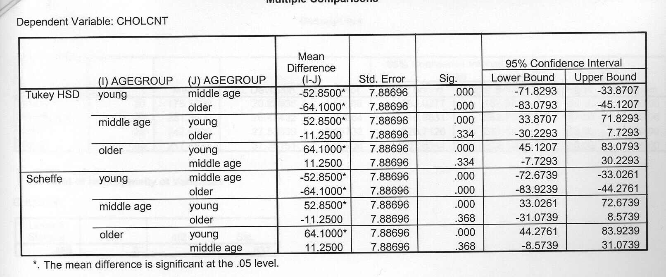
Cumulative Type 1 Error & Post Hoc Tests
Post Hoc Tests in SPSS

Slide 44
Part 5
One-way ANOVAs in SPSS

Slide 45
